Slide 1
MindGames
Computer Science
Brandon Knotek (bk11@hood.edu) Walid Muhammad (wm5@hood.edu) Jack Wilder (jmw38@hood.edu)

Slide 2
Our Goal
Neurofeedback to control real-time interactive experiences

Slide 3
Our Goal
Neurofeedback to control real-time interactive experiences
Gameplay just by thinking commands
No mouse, No keyboard, No voice

Slide 4
Motivation
Accessibility
Physical disabilities can limit traditional input methods
Communication
Conditions can make movement and speech impossible (Locked In Syndrome)

Slide 5
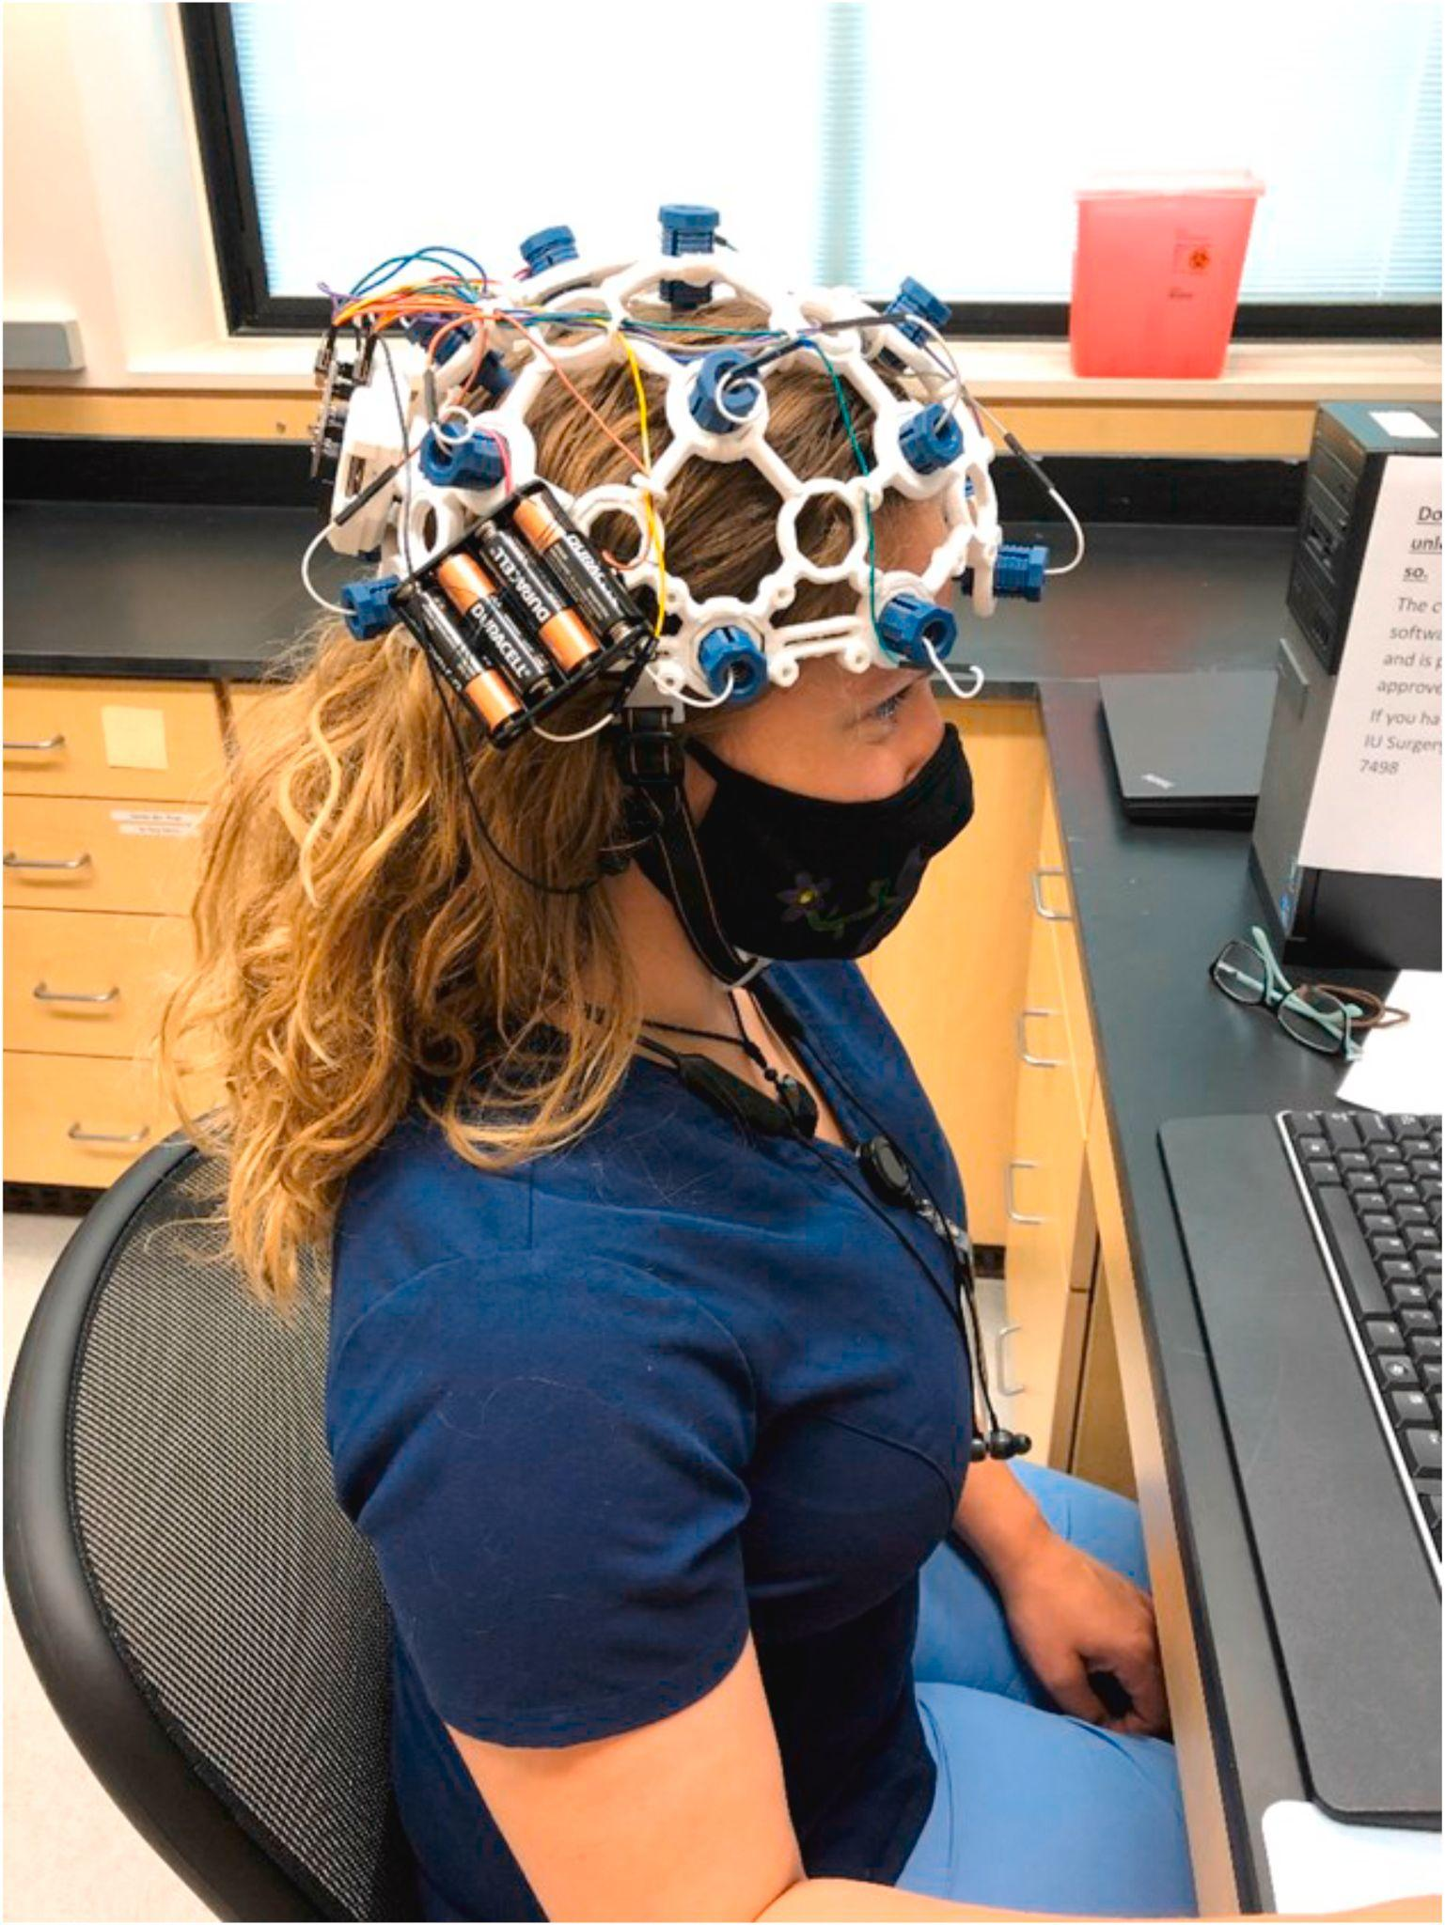
How Does It Work?
Brain activity (signals) sent to computer
Computer processes signals to commands
Commands sent to software and executed
Fig. 1 - Using an OpenBCI Ultracortex headset to interact with a computer

Slide 6
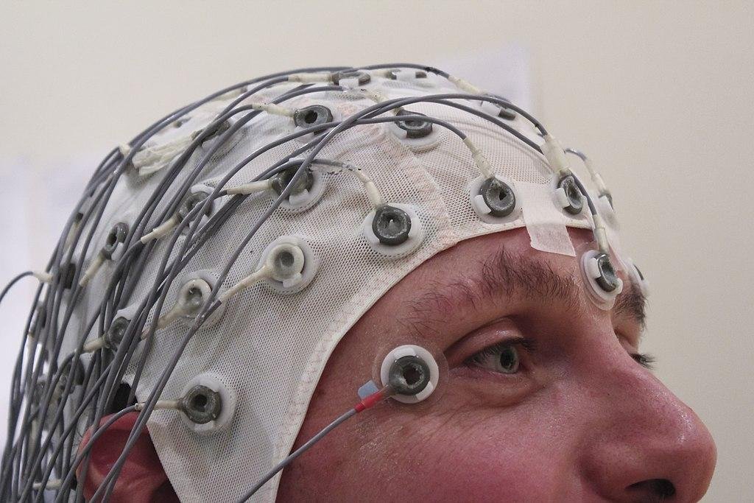
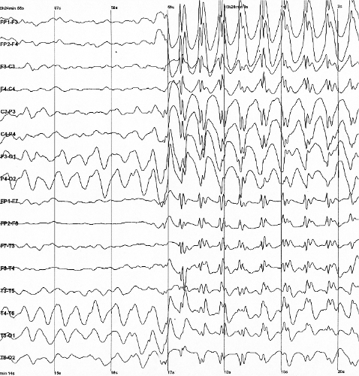
Unraveling the Brain
All brain activity = electrical
Electroencephalography (EEG) uses electrodes to measure activity
Different thoughts, actions, and mental states produce unique electrical patterns
Patterns different between individuals
Fig. 2 - An example of EEG hardware
Fig. 3 - Sample EEG output

Slide 7
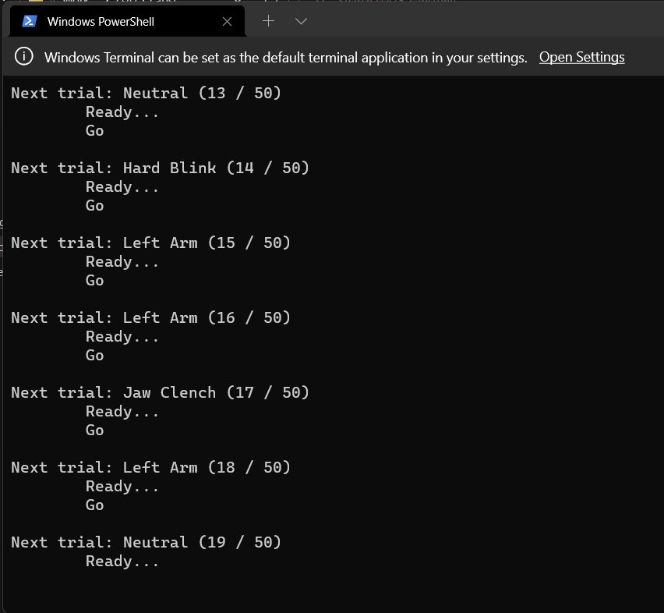
Building a Neural Fingerprint
Computer training:
Recognize an individual’s unique patterns
Machine Learning (ML):
Computer associating labeled patterns with commands
Fig. 4 - Calibration module collecting training data

Slide 8
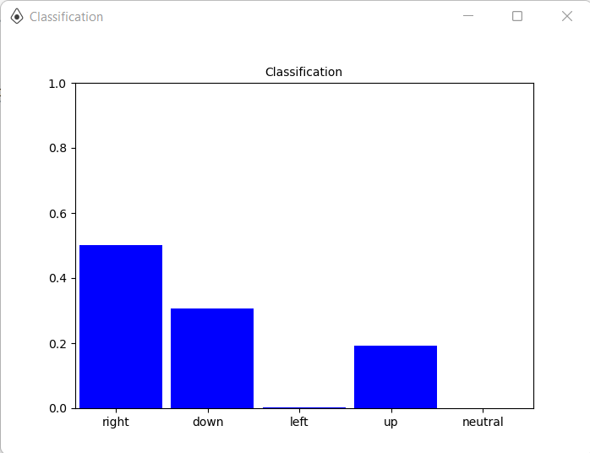
Command Classification
Enough examples for ML model to classify patterns on its own
Using Probability:
Determines most likely command given pattern
Fig. 5 - Visualization of model’s classification output

Slide 9
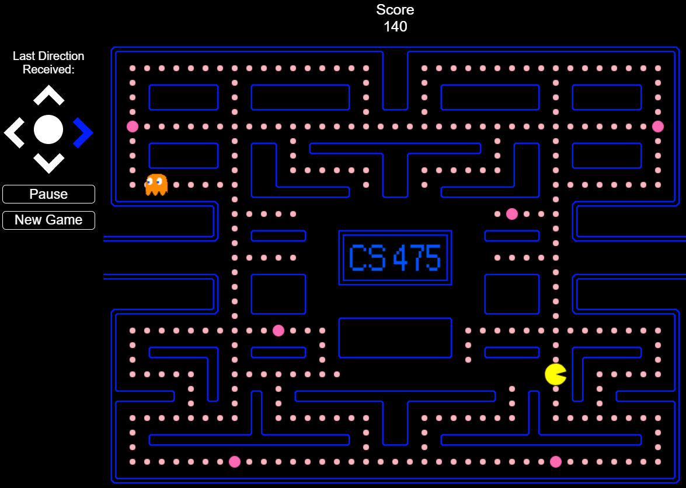
Playing the Game
Most likely command sent to game
Command executed, Pac Man moves
Fig. 6 - Pac Man in action

Slide 10
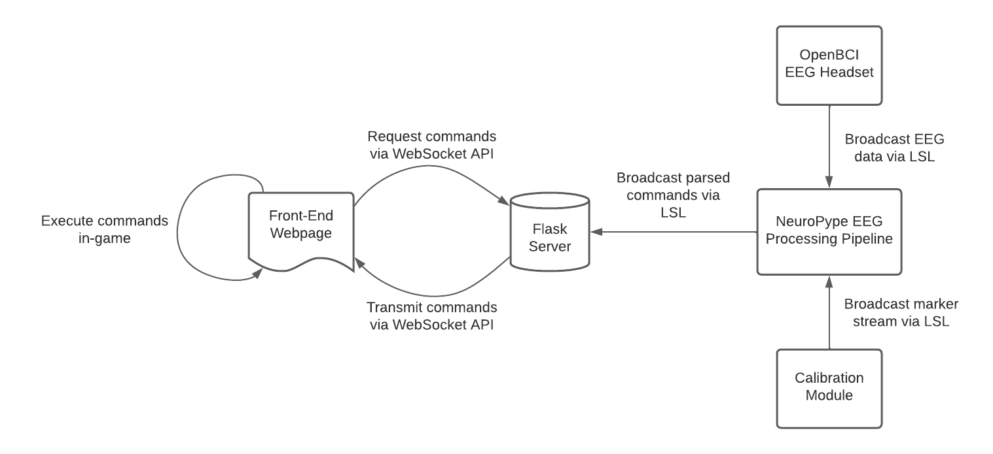
System Overview
Fig. 7 - A diagram of the MindGames system architecture

Slide 11
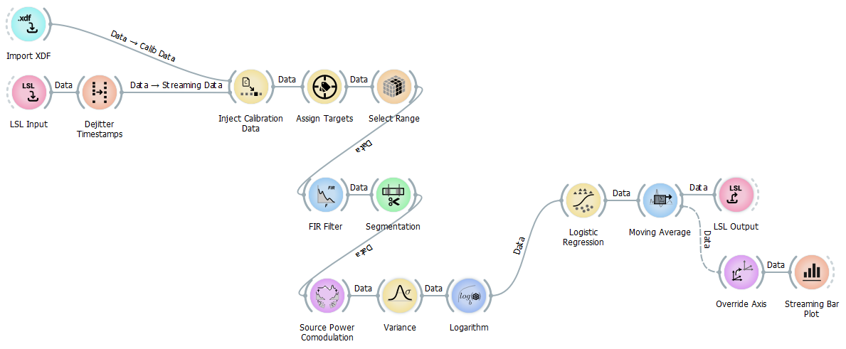
EEG Processing Pipeline
Fig. 8 - The MindGames EEG processing pipeline

Slide 12
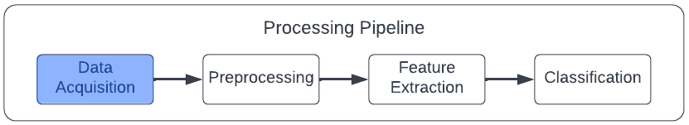
EEG Processing Pipeline - Data Acquisition
Get EEG data and ML training labels into the pipeline
Assign training labels to commands
Fig. 9 - EEG pipeline data acquisition component

Slide 13
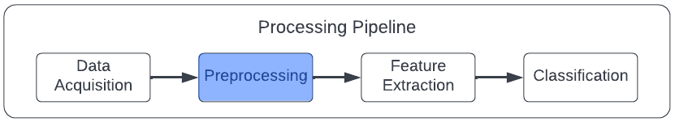
EEG Processing Pipeline - Preprocessing
Filter out electrical noise
Designate length of data “chunks” to associate with labels
Fig. 10 - EEG pipeline preprocessing component

Slide 14
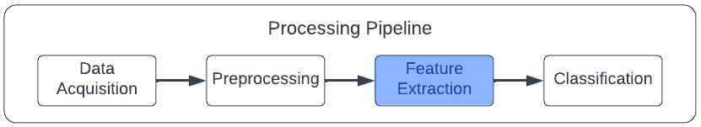
EEG Processing Pipeline - Feature Extraction
Extract EEG signal components that exhibit the most variance between commands
Reduce the volume of data to make ML classification more efficient
Fig. 11 - EEG pipeline feature extraction component

Slide 15
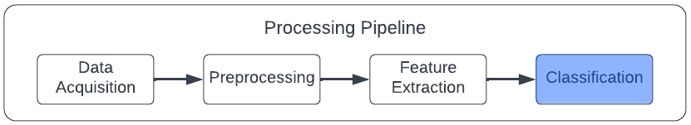
EEG Processing Pipeline - Classification
Use extracted features to determine command probabilities
Maintain a moving average of probabilities to reduce noise
Output probabilities for further use
Fig. 12 - EEG pipeline classification component

Slide 16
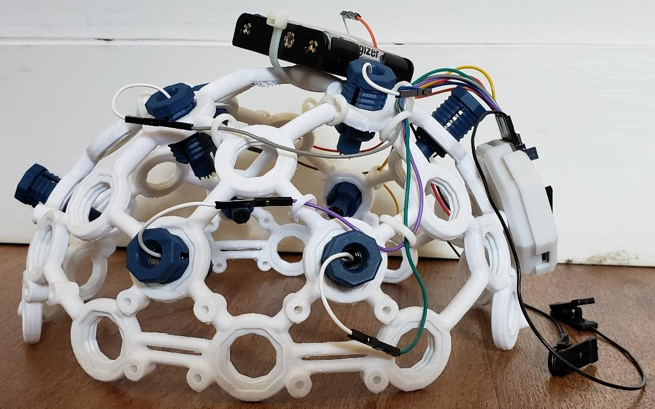
Challenges - Hardware
OpenBCI Ultracortex headset
8 electrodes (professional: 128)
Difficult to secure
Small movements cause it to shift position
Electrodes move: spikes, invalidating training data
RESULT:
Low quality data (and not enough of it)
Fig. 13 - Ultracortex headset, profile view

Slide 17
Challenges - Software
Training time: 8 minutes
Results subject to hardware challenges
Noise and unrelated spikes (e.g., blinking, swallowing)
Must be filtered out without affecting relevant signals
Thought to Action: minimal latency for the game to feel responsive

Slide 18
Next Steps
Fine-tune our noise reduction and ML classification techniques
Devise a system to secure the headset in place
Transition from classifying movements to classifying imagined movements (motor imagery)

Slide 19
Team Dynamics
Equitable distribution of work:
Coding, Research, Reports/Demonstrations

Slide 20
Demonstration Movie

Slide 21
Questions?

